Slide 1
Introduction to Machine Learning
Course : COMP6065001 Artificial Intelligence
Effective Period : September 2023
Session 15

Slide 2
Learning Outcomes
At the end of this session, students will be able to:
LO 1: Describe what is AI and identify concept of intelligent agent
LO 4: Apply various learning algorithms to solve the problems

Slide 3
Outline
What is Machine Learning?
How can we solve a specific problems?
Categories of Machine Learning
Component Machine Learning Algorithm

Slide 4
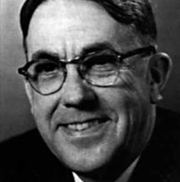
What is Machine Learning
Machine learning is the field of study that gives computers the ability to learn without being explicitly programmed — Arthur L. Samuel, AI pioneer, 1959

Slide 5
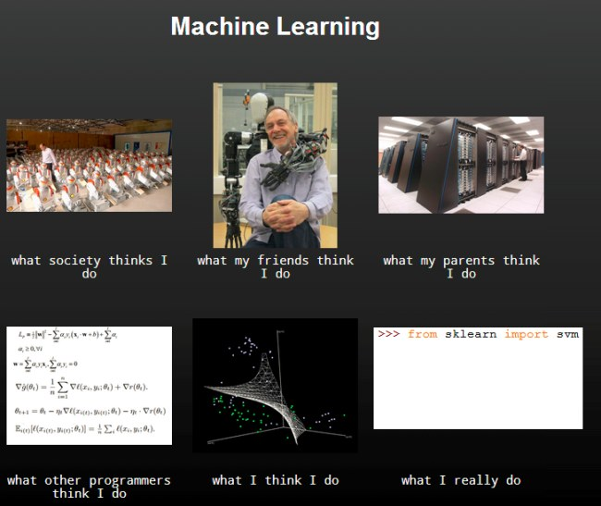
Source

Slide 6
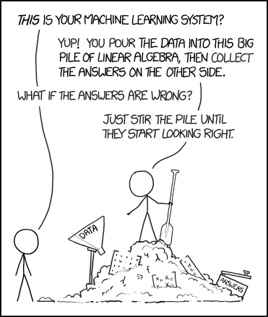

Slide 7
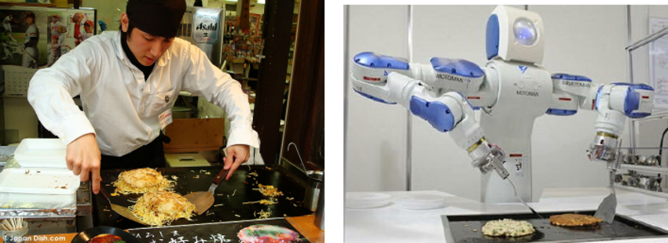
How can we solve a specific Problem
How can we solve a specific problems?
We need to write a program that encodes a set of rules that are useful to solve the problem
Source images: Alessandro Pieropan, Action Recognition for Robot Learning

Slide 8
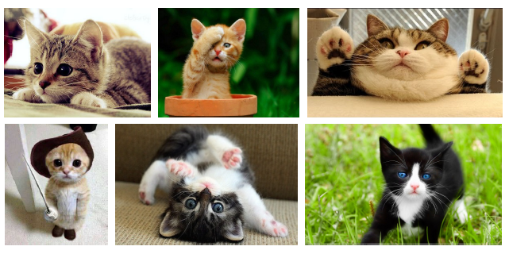
How can we solve a specific Problem
How can we solve a specific problems?
We need to write a program that encodes a set of rules that are useful to solve the problem
In many cases is very difficult to specify those rules, e.g. given a picture determine whether there is a cat in the image
Source images: Raquel Urtasun, Richard Zemmel and Sanja Findler, Introduction to Machine learning

Slide 9
How can we solve a specific Problem
How can we solve a specific problems?
We need to write a program that encodes a set of rules that are useful to solve the problem
In many cases is very difficult to specify those rules, e.g. given a picture determine whether there is a cat in the image
Learning Systems are not directly programmed to solve a problem, instead develop own program based on:
Examples of how they should behave
From trial-and-error experience trying to solve the problem
Learning simply means incorporating information from the training examples into the system

Slide 10
Categories of Machine Learning
The three broad categories of machine learning:
Supervised
Unsupervised
Reinforcement Learning

Slide 11
Categories of Machine Learning
Supervised
Labeled data
Direct Feedback
Unsupervised
No labels
No feedbacks
Reinforcement Learning
Decision Process
Reward System
Predict outcome/future
Find hidden structure in data
Learn series of action

Slide 12
Supervised Learning
Supervised learning is the subcategory of machine learning that focuses on learning a classification or regression model.
learning from labeled training data (i.e., inputs that also contain the desired outputs or targets; basically, “examples” of what we want to predict).

Slide 13
Supervised Learning
Classification: 1-of-N output (speech recognition, object recognition, medical diagnosis)
Regression: real-valued output (predicting market prices, customer rating)

Slide 14
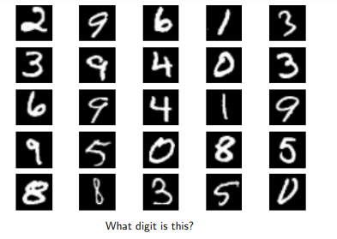
Supervised Learning
Source images: Raquel Urtasun, Richard Zemmel and Sanja Findler, Introduction to Machine learning

Slide 15

Supervised Learning
Source images: Raquel Urtasun, Richard Zemmel and Sanja Findler, Introduction to Machine learning

Slide 16
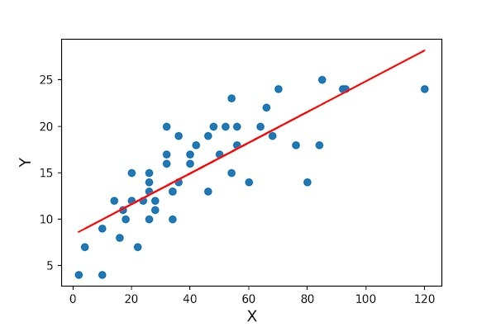
Supervised Learning
Source images: Raquel Urtasun, Richard Zemmel and Sanja Findler, Introduction to Machine learning

Slide 17
Unsupervised Learning
Unsupervised learning is a branch of machine learning that is concerned with unlabeled data.
Common tasks in unsupervised learning:
Clustering analysis
Dimensionality data reduction

Slide 18
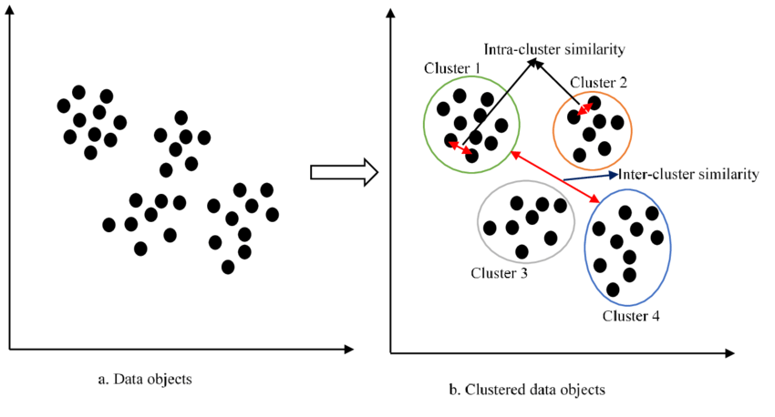
Unsupervised Learning
Source images: Ezuguwu et.al., Automatic clustering algorithms: a systematic review and bibliometric analysis of relevant literature, Neural Computing and Application

Slide 19
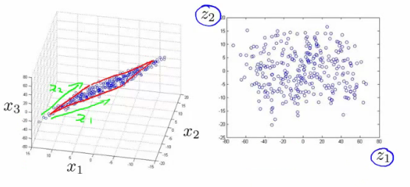
Unsupervised Learning
Source Image: https://www.analyticsvidhya.com/blog/2015/07/dimension-reduction-methods/

Slide 20
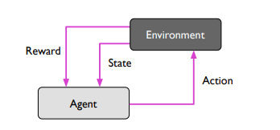
Reinforcement Learning
Reinforcement is the process of learning from rewards while performing a series of actions
In reinforcement learning, we do not tell the learner or agent (for example, a robot), which action to take but merely assign a reward to each action and/or the overall outcome

Slide 21

Reinforcement Learning

Slide 22
Classes of Machine Learning Algorithm
Generalized linear models (e.g., logistic regression)
Support vector machines (e.g., linear SVM, RBF-kernel SVM)
Artificial neural networks (e.g., multi-layer perceptrons)
Tree- or rule-based models (e.g., decision trees)
Graphical models (e.g., Bayesian networks)
Ensembles (e.g., Random Forest)
Instance-based learners (e.g., K-nearest neighbors)

Slide 23
Algorithm Categorization Scheme
eager vs lazy;
batch vs online;
parametric vs nonparametric;
discriminative vs generative.

Slide 24
Component Machine Learning Algorithm
Define the problem to be solved
Collect and/or labeled data
Choose an algorithm class
Choose an optimization metric for learning the model
Choose a metric for evaluating the model.

Slide 25
References
Sebastian Raschka, Introduction to Machine Learning: Lecturer Notes, University of Wisconsin-Madison, Fall 2021
Raquel Urtasun, Richard Zemmel and Sanja Findler, CSC 441: Introduction, University of Toronto, Fall 2016

